Slide 1


Seasonal Distribution pattern of spring chinook salmon in Willamette Valley Project reservoirs
Principal Investigators:
Fred R. Monzyk
Jeremy D. Romer
Ryan Emig
Thomas A. Friesen
Oregon Department of Fish and Wildlife
Corvallis Research Lab
Corvallis, Oregon
Notes:
Summarize results from spring distribution work over the last few years
Show results from summer and fall distribution work from 2014

Slide 2
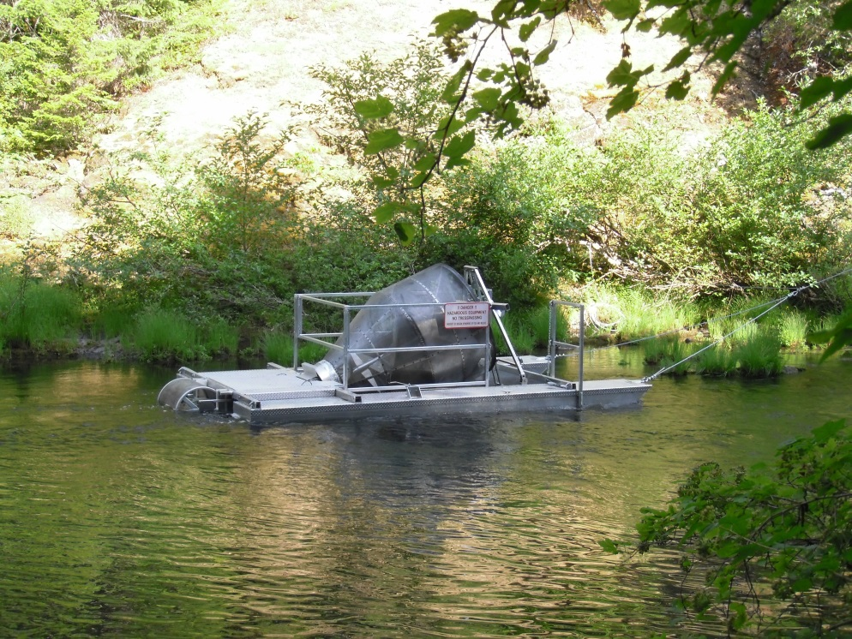
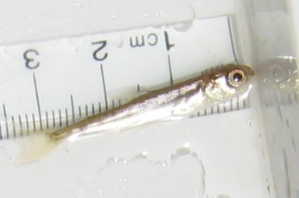
Background
Most juvenile Chinook enter reservoirs in spring as fry (mean FL=35 mm).
Notes:
~90% of juvenile Chinook enter as fry

Slide 3
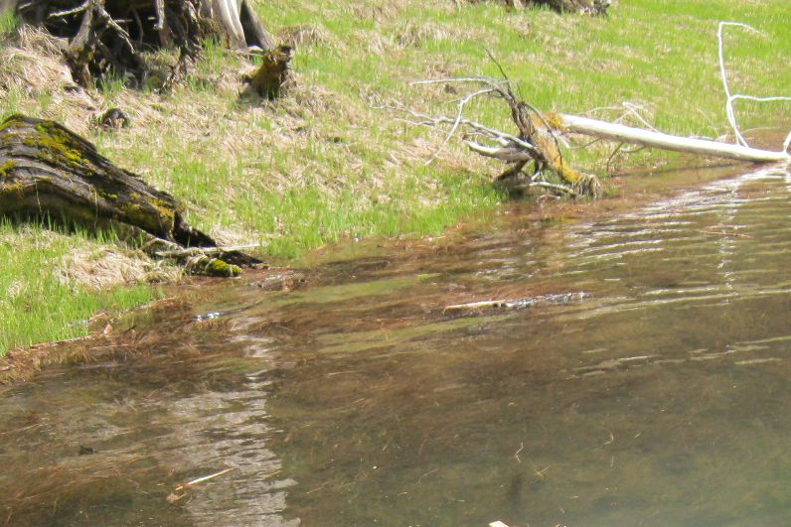
Background
Subyearlings use nearshore
habitat in the spring
Move offshore into deeper water in the summer
Return to surface in the fall
Notes:
Fry occupy shallow nearshore habitat in spring (often times see small schools close to shore)

Slide 4
Background
Vertical Distribution

Slide 5
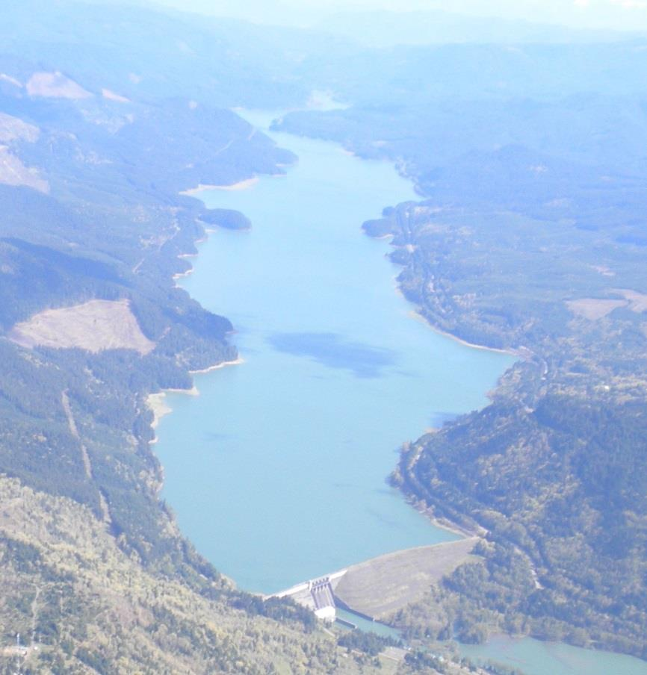
Where are they???
Spring
?
Summer
Fall
Lookout Point
Information needed for designing downstream passage
Notes:
Our question was-How are they distributed longitudinally (from HoR to Dam) in each season? If passage structure built at forebay, need to know if fish will be available.

Slide 6
Background/Objectives
Evaluated longitudinal distribution (HoR to Dam) of subyearlings in the spring 2011-2014.
Cougar, Detroit, Foster, Lookout Point (LOP)
In 2014, evaluated longitudinal distribution in the summer and fall (pilot effort in fall 2013).
LOP only

Slide 7
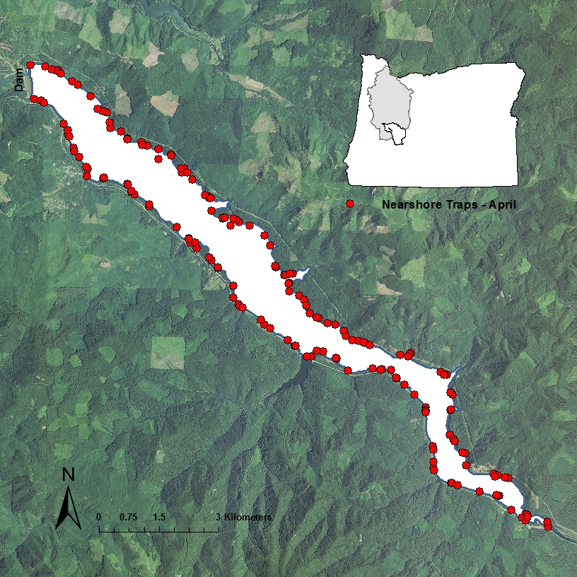
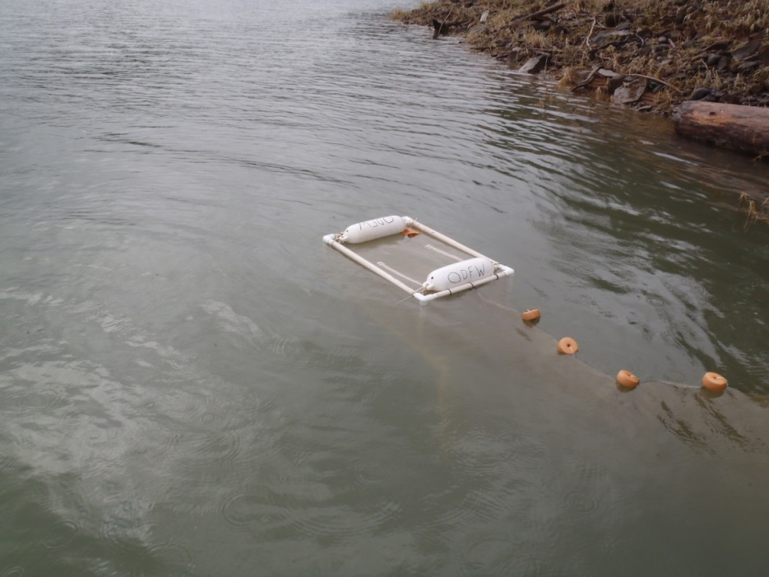
Methods
Spring
Nearshore nets set throughout reservoirs
3 months in spring (Mar-Jun)
Checked daily
Cumulative distribution by res length
2x2x3’ box trap w/ 5-m lead net
Notes:
Set small box traps and Oneida traps throughout nearshore areas with a stratified random sampling design to ensure good coverage all the res.

Slide 8
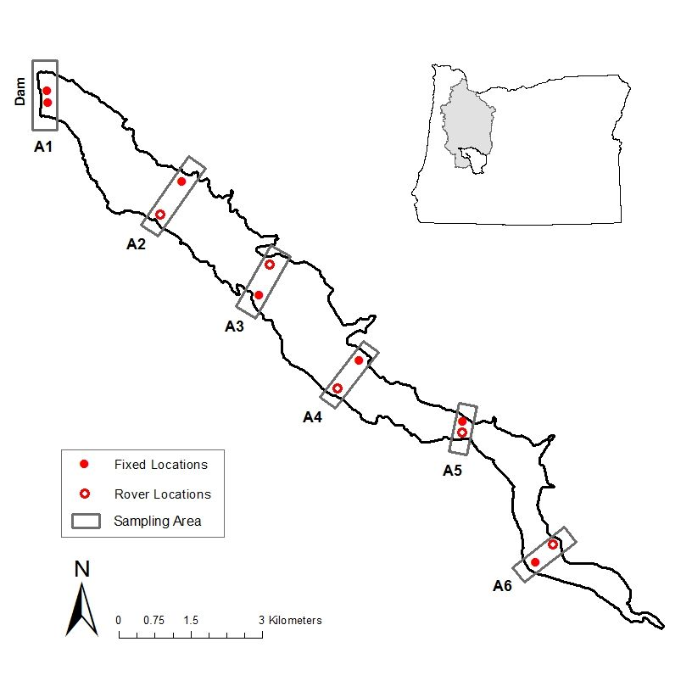
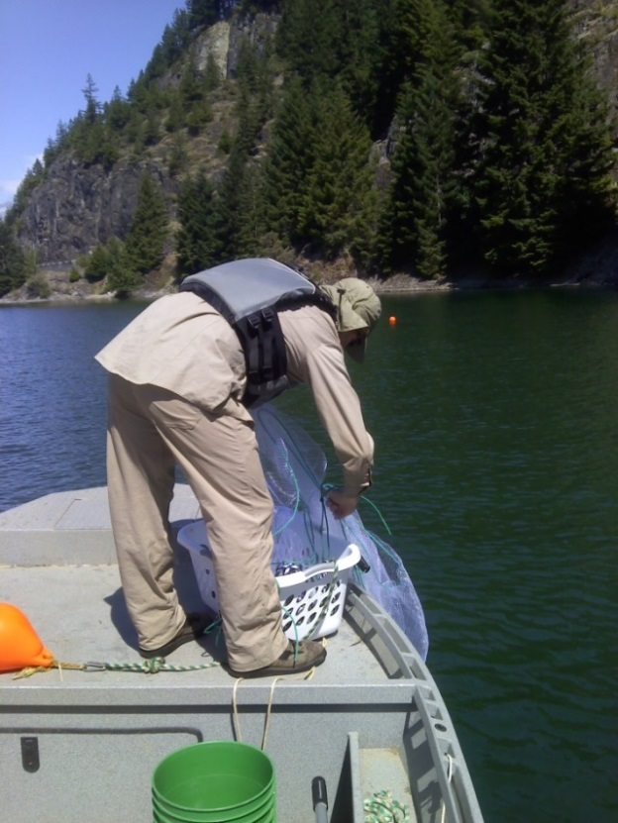
Methods
Summer and Fall
Gill nets set in 6 areas of LOP (all with steep slopes)
Set 45-65’ deep in summer (Jul-Aug ) and surface in fall (Oct-Nov)
Compared catch between areas w/ Kruskal-Wallis test (α=0.05) (hatchery and natural origin)
Notes:
We used gill nets in summer and fall since subs were larger and occupying different (pelagic) habitat.

Slide 9
Results
Spring

Slide 10
Results
Spring
Subyearlings more abundant near HoR, except at Foster
South Santiam Arm
Notes:
Cougar, Lookout Point (and Detroit –not shown) have similar cumulative distributions with more subs near the HoR. Foster demonstrated different pattern. Foster is the smallest/shallowest reservoir and SS arm effectively reduces the size even more.

Slide 11
Results
Spring
Subyearlings disperse further into reservoir each month
Cougar Reservoir -2014

Slide 12
Results
Spring
Lookout Point 2014 (viewed another way)
1
2
3
Divided reservoir
into 6 areas for
comparison to
summer and fall
catch
4
5
Dam
1 2 3 4 5 6
HoR
6
Notes:
Instead of looking at catch

Slide 13
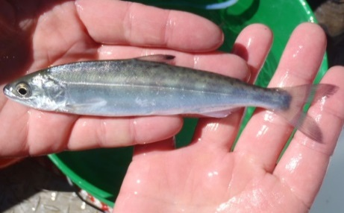
Results
Summer
Milling?
Chinook catch
Too
warm
Too
warm
Dam
A6
HoR
Dam
A6
HoR
Reservoir area
Reservoir area
Reservoir area
Bimodal distribution –subyearlings at dam and near HoR
23% of A5 hatchery catch comprised of forebay release group
38% of A1 hatchery catch comprised of HoR release group
Notes:
Area 6 was too warm and shallow to hold fish (1 fish caught out of 20 sets).
Kruskal-Wallis One-Way ANOVA with Dunn’s multiple comparison tests. Letter in common are not signf. different

Slide 14
Results
Summer
Conceptual model of movement patterns
that would cause bimodal distributions
Warm/
shallow water
Dam
Notes:
Conceptual model of movement/milling pattern that would cause a bimodal distribution.
Bottom line: there are fish in the forebay available for passage.

Slide 15
Results
Fall

Slide 16

Results
Fall
Chinook catch
Dry
Dry
z z y y y y
Dam
A6
HoR
Dam
A6
HoR
Subyearlings moved towards dam
Distribution developed before outflows increased
Notes:
Fall Distribution shows subs moved towards dam

Slide 17
Results
Fall
Distribution pattern developed prior to
discharge increases
Consistent with downstream movement to
overwintering habitat

Slide 18
Conclusions
Distribution shifted from HoR to Dam from spring to fall
Bimodal summer distribution
Traversing, milling at barrier behavior??
Fall distribution consistent with downstream movement to overwintering habitat observed for unimpounded populations

Slide 19
Acknowledgements
Greg Taylor
Chad Helms
Doug Garletts
Todd Pierce
Nat Erickson
Rich Piaskowski
Jeff Ziller
Kelly Reis
The ‘Reservoir Dogs’
Khoury Hickman
Chris Abbes
Greg Gilham
Andrew Nordick
Meghan Horne-Brine
John Elliott
Kevin Stertz
Ryan Flaherty
JD Hansen

Slide 20
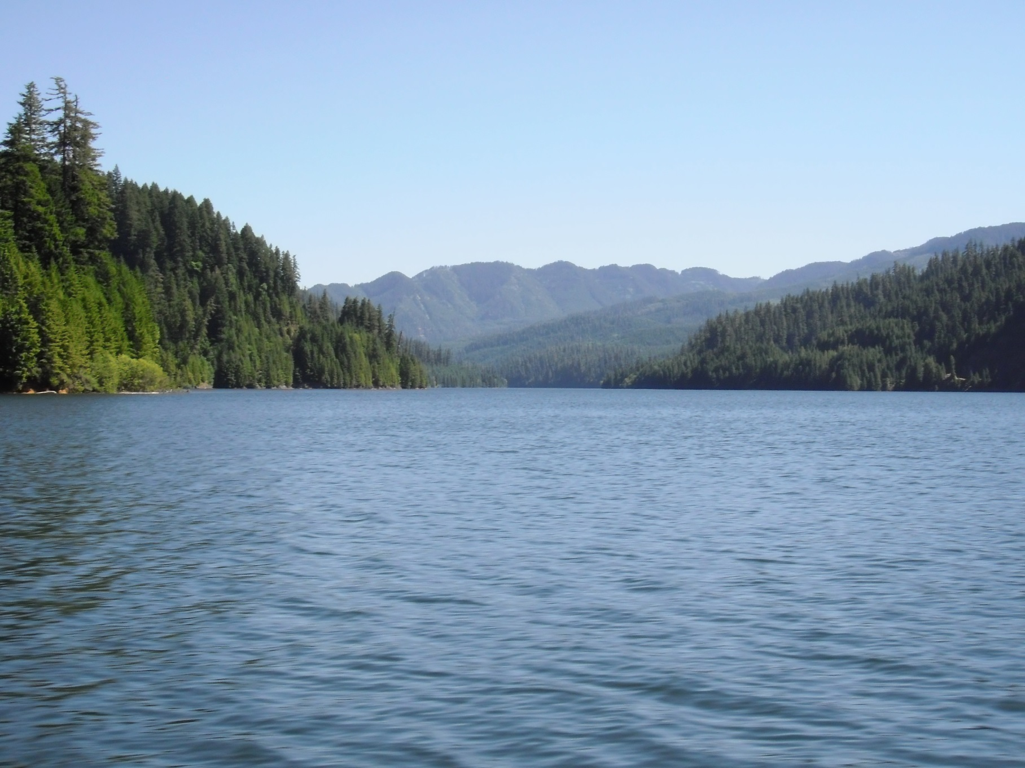
Questions?

